Slide 1

ADAPTIVE & SELF-LEARNING SMART STREET LIGHTING AUTOMATION
THE VIGYAANEERS
> Paras Lehana
> Ayushmaan Bansal
> Yash Garg
> Abhinav Bansal

Slide 2
Abstract
The Smart Lightning module deploys features like adaptive lightning control that senses the light intensity around the sensors and control the light toggle accordingly. Moreover, the data collected through the phototransistor along with other data points like time, area and master control are then fed to a Fuzzy Inference System (FIS) that could be used to generate self-learned and modified threshold levels for light toggles. Since street lights in a city-wide area can be numerous, approaches for Data Mining and Big Data options are also explored.

Slide 3
Introduction
Present era is about Automation Industry involving less manual interaction thus making it more accurate and highly flexible.
Our project is about controlling the lights automatically with the help of centralised system having control of all lights at same place.
LDR detect the intensity of light in surrounding and accordingly on the basis of threshold set performs switching of lights.
Also on the basis of the data collected from the surrounding data mining techniques are employed to get the best timing and threshold values.
Having a centralised control further makes it easy to detect any fault in the lightning system and rectify which manually is next to impossible.

Slide 4
Hardware Description
ESP8266
Light Dependent Resistor (LDR)
ULN2003 IC
Light Emitting Diode (LED)
TelosB Mote

Slide 5
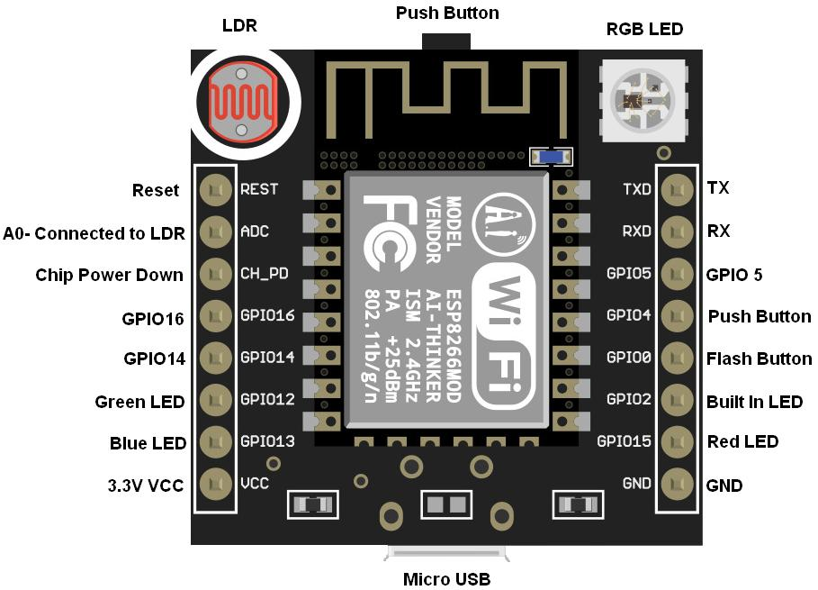
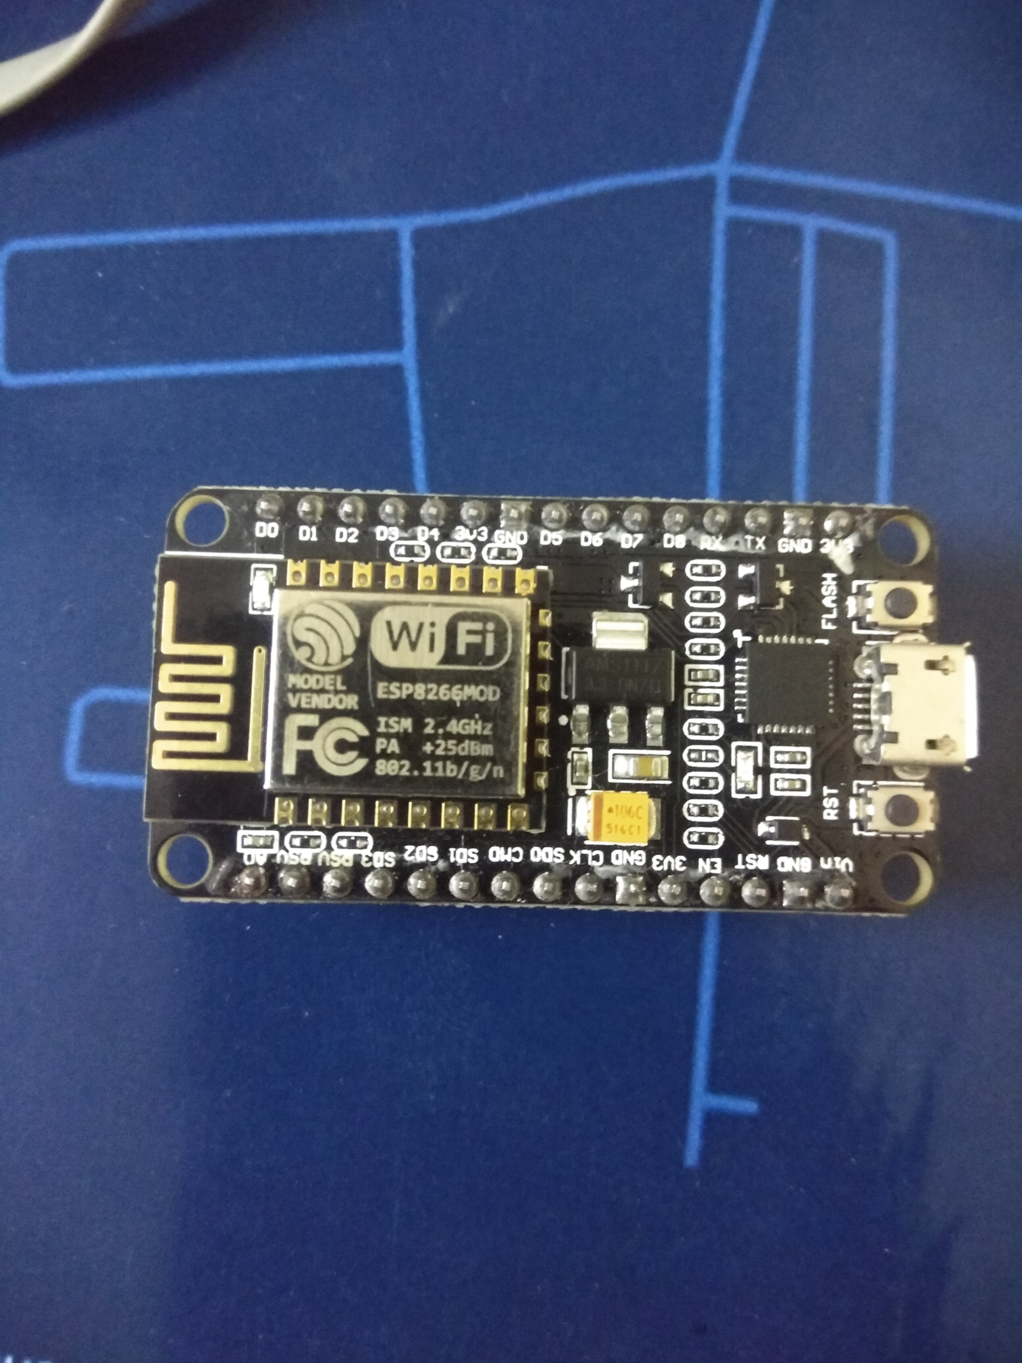
ESP8266
The ESP8266 WiFi Module is a self contained SOC with integrated TCP/IP protocol stack that can give any microcontroller access to your WiFi network.
The ESP8266 is capable of either hosting an application or offloading all Wi-Fi networking functions from another application processor.

Slide 6
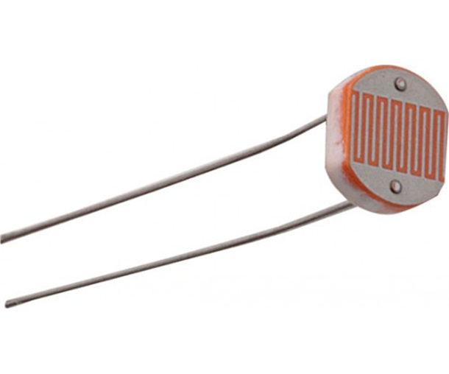
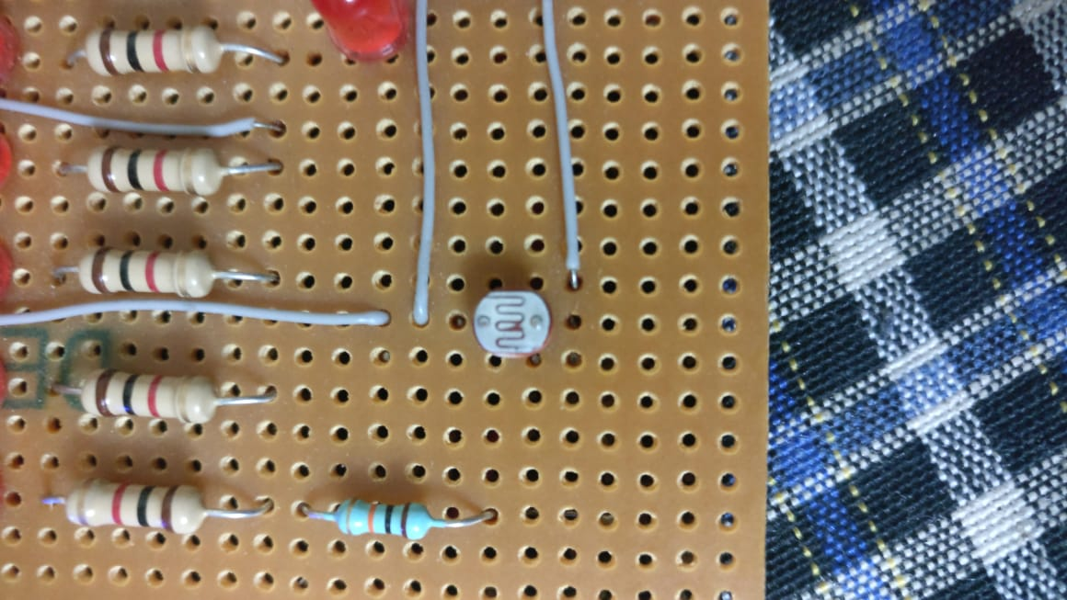
Light Dependent Resistor
An LDR is a component that has a (variable) resistance that changes with the light intensity that falls upon it.
LDR is used in project to detect the environment visibility parameters at any time so as to take corresponding decisions about switching on/off lights.

Slide 7
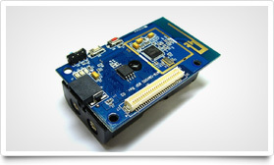
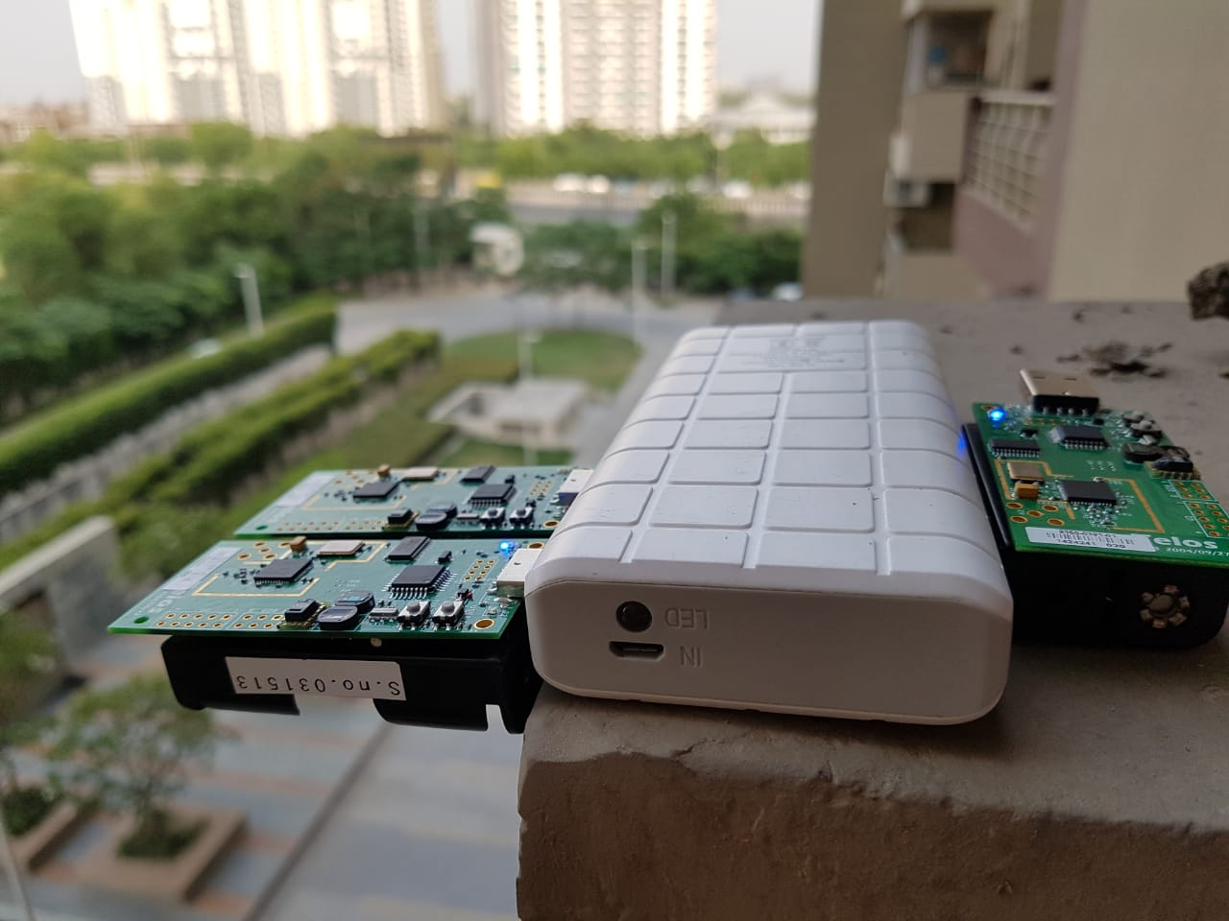
TelosB
TelosB is a wireless sensor network device which has sensor devices such as solar radiation sensor, humidity temperature sensor, USB, Antenna, deformation meter and microcontroller.
It has total 8 sensor channels with high compassion which is mostly used for research or experimental purpose in an organization.

Slide 8
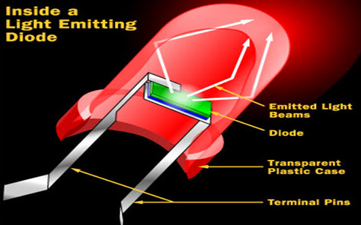
Light Emitting Diode(LED)
Light Emitting Diode is a semiconductor light source.
LEDs are used as indicator lamps in many devices, and are increasingly used for lightning.
LEDs were introduced as a practical electronic component in 1962.

Slide 9
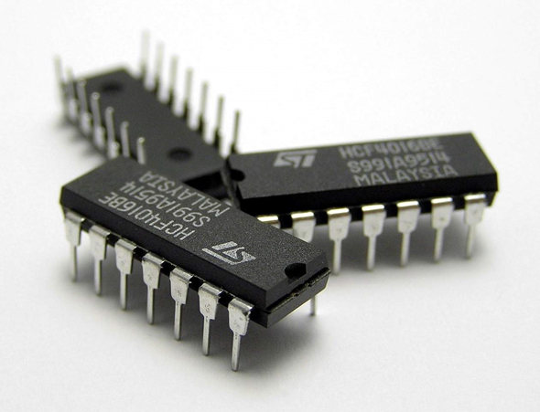
Integrated Circuit(IC)
An Integrated circuit sometimes called chips or microchip, is a semiconductor wafer on which thousand or millions of tiny resistor, capacitor and transistor are fabricated. An IC can function as an amplifier ,oscillator, timer, counter ,Computer memory or microprocessor, Ics have two main advantages over discrete circuit :cost and Performance.
Cost is low because the chips ,with all their components are printed as a Unit by photolithography rather than being constructed one transistor at a time

Slide 10
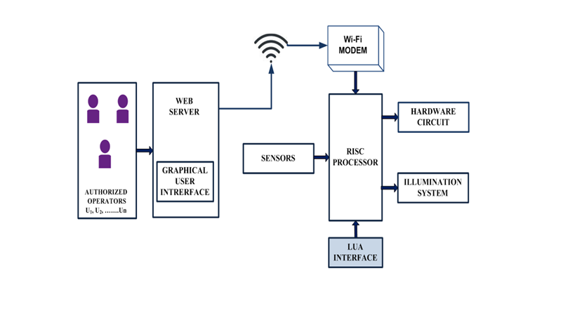
Block Diagram

Slide 11
Working of the Project
The working of the project can be clearly explained by considering the street lights.
The main aim of the project is to automate the ON/OFF of the street lights on the basis of environment conditions.
In this project LDRs are used for sensing the external environment conditions.
Data provided by LDR is used to do analysis over which the decision of switching ON/OFF lights is made by the system automatically.

Slide 12
Software Used
Lua Compiler – NodeMCU
It is small, fast, portable, and embeddable.
As a small language comprising less than 10,000 lines of C code, Lua is extremely stable and virtually bug-free.
Lua has a unique place in the up-and-coming Internet of Things (IoT) device industry.

Slide 13
Installation
Download and install CP2101 driver
Download NodeMCU firmware flasher (EXE)
Download ESPlorer IDE (JAR)

Slide 14
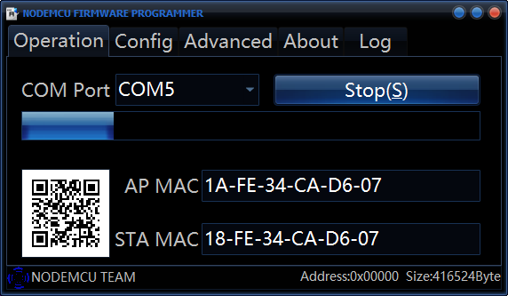
NodeMCU Firmware

Slide 15
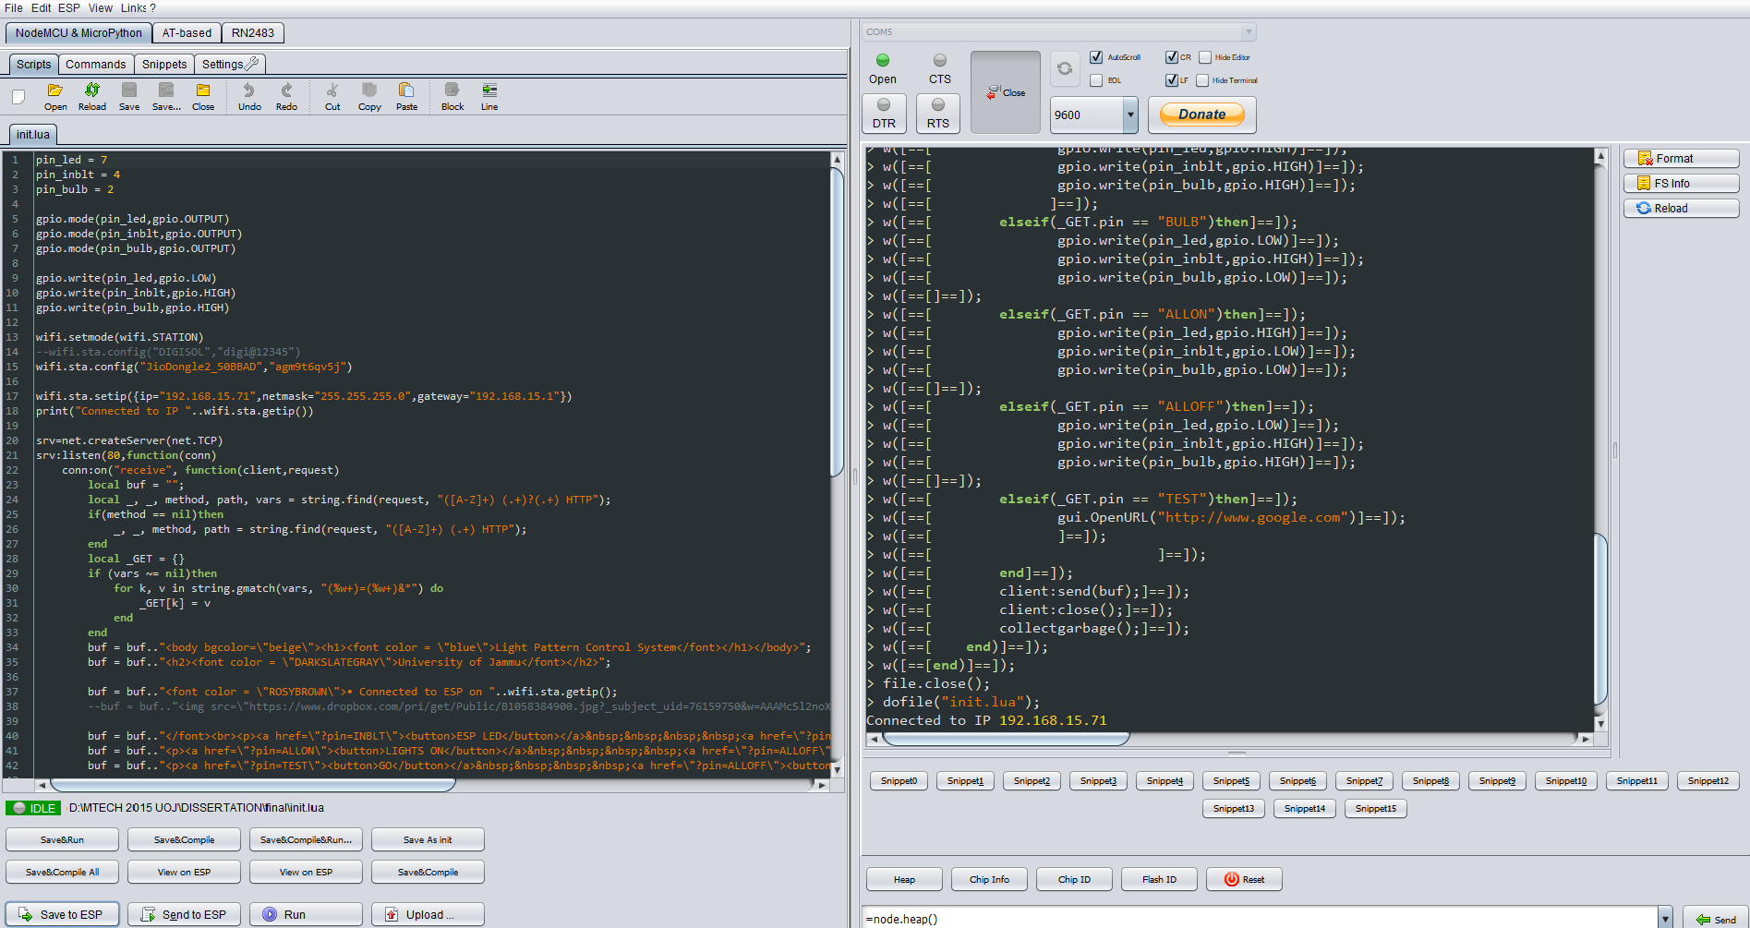
ESPlorer

Slide 16
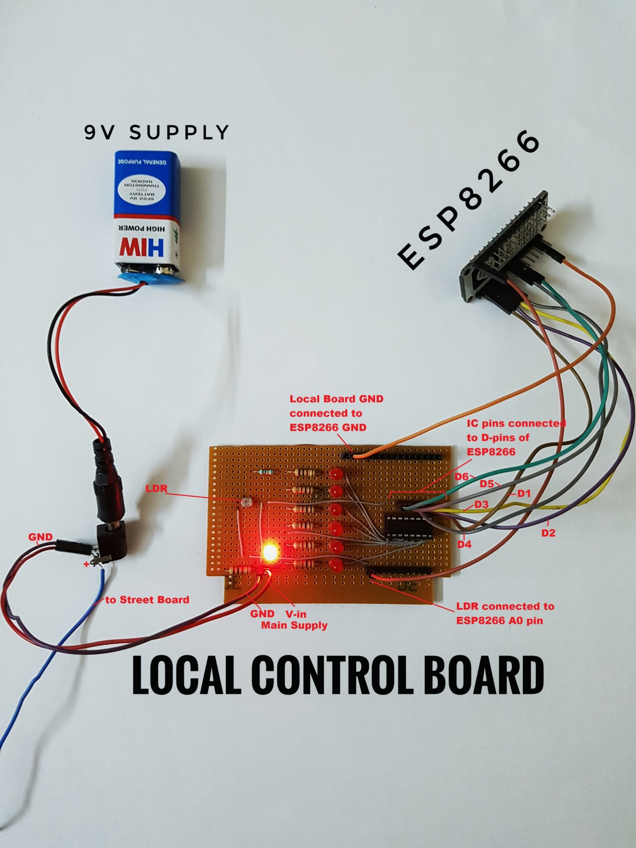
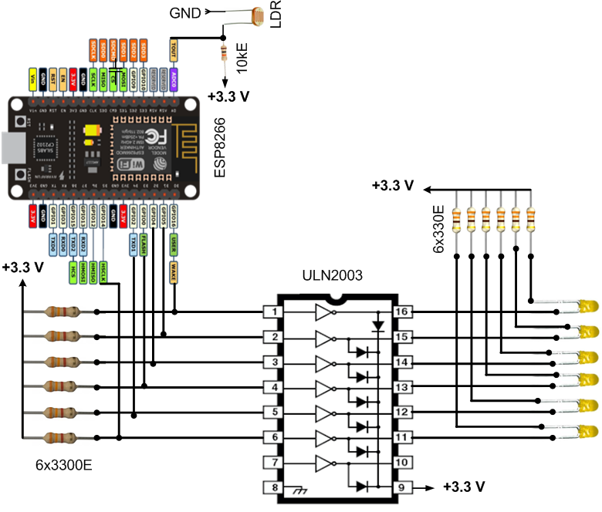
Local Control Board

Slide 17
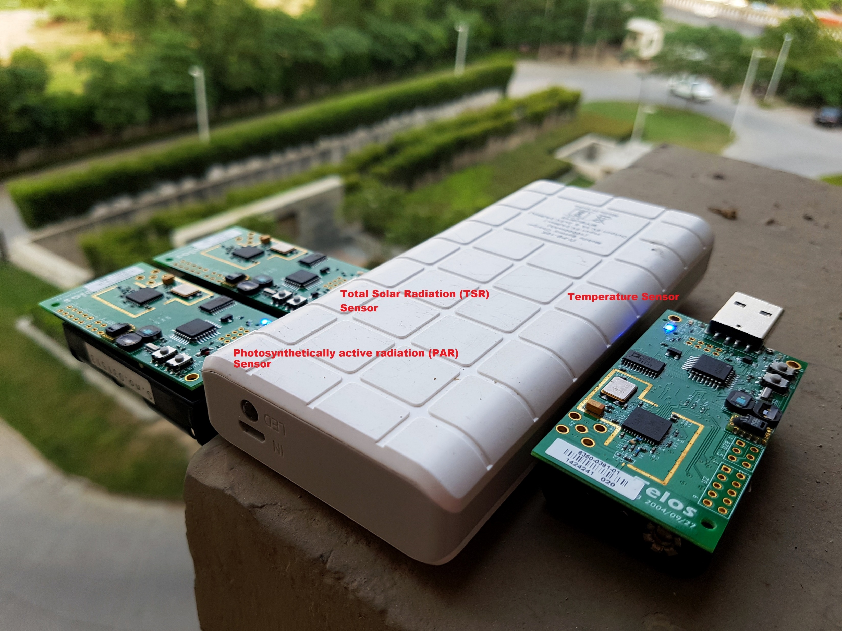
Sensing - TelosB

Slide 18
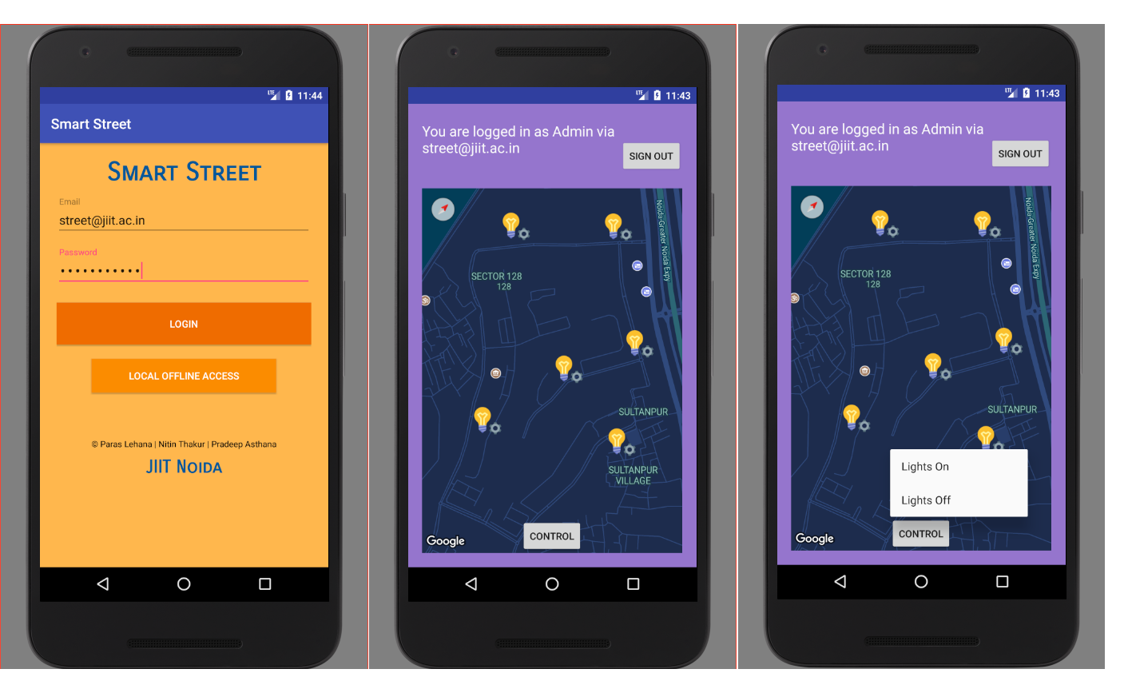
Master Control

Slide 19
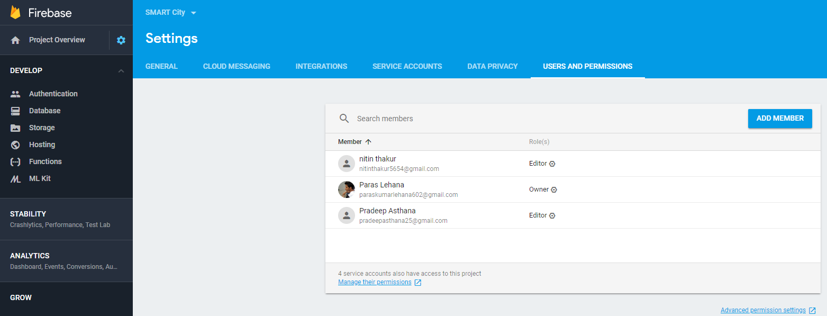
Cloud Authentication -> Identity & Access Management

Slide 20
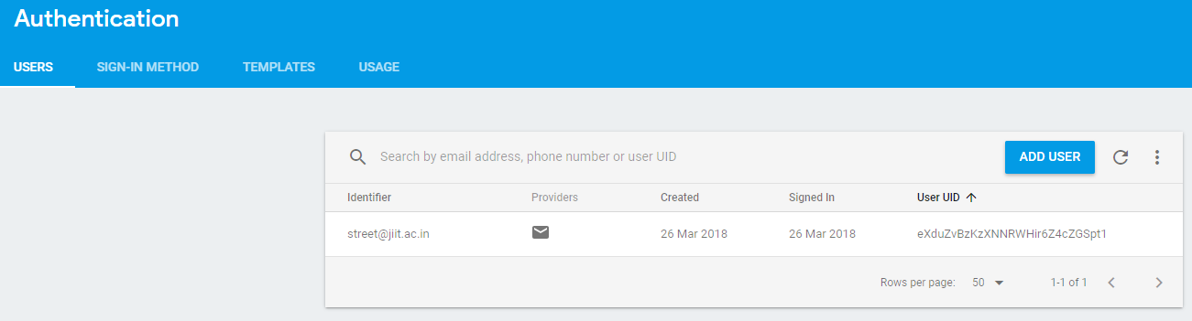
Cloud Authentication -> Application users

Slide 21
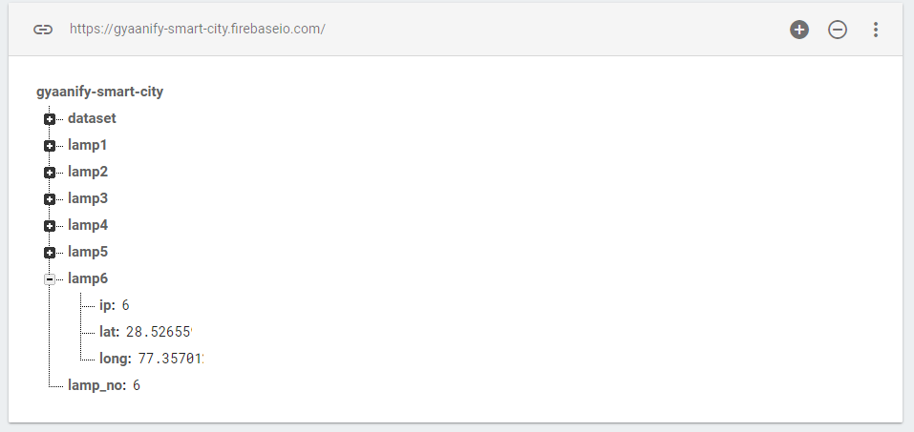
Cloud Realtime Database

Slide 22
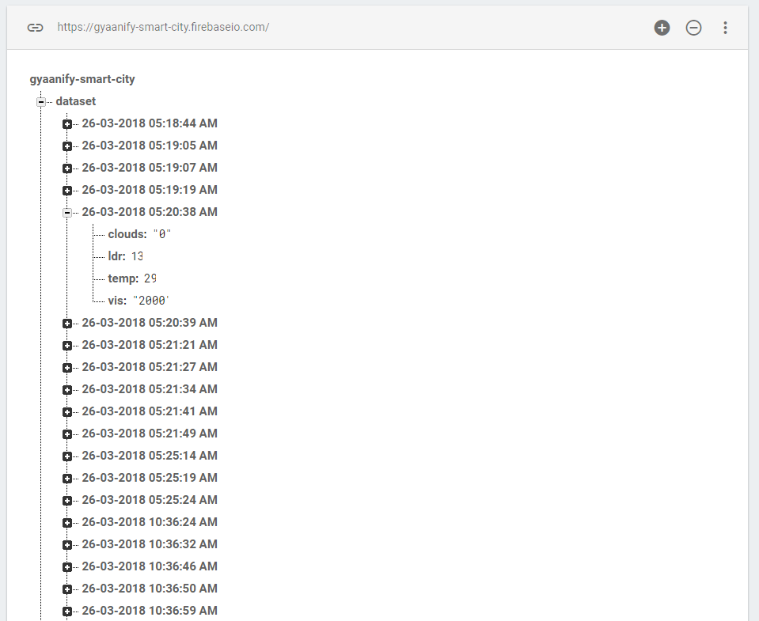
Cloud Dataset

Slide 23
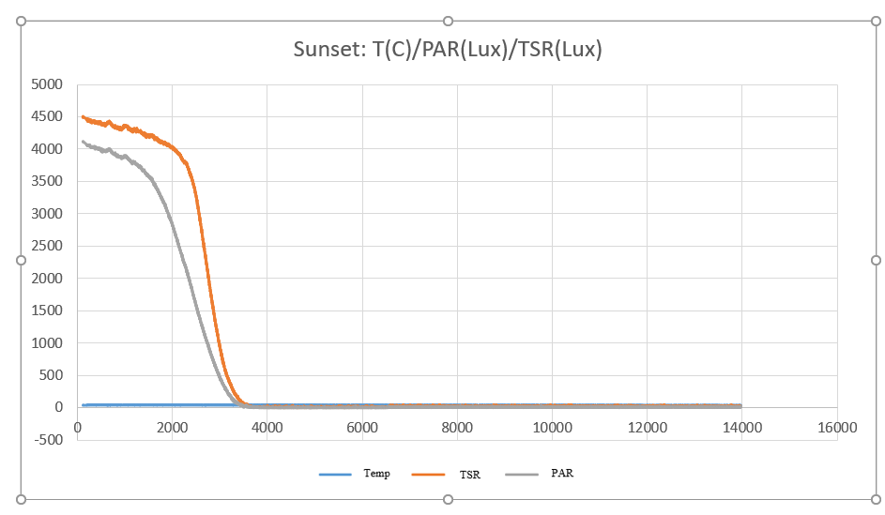
Sensing – Results

Slide 24
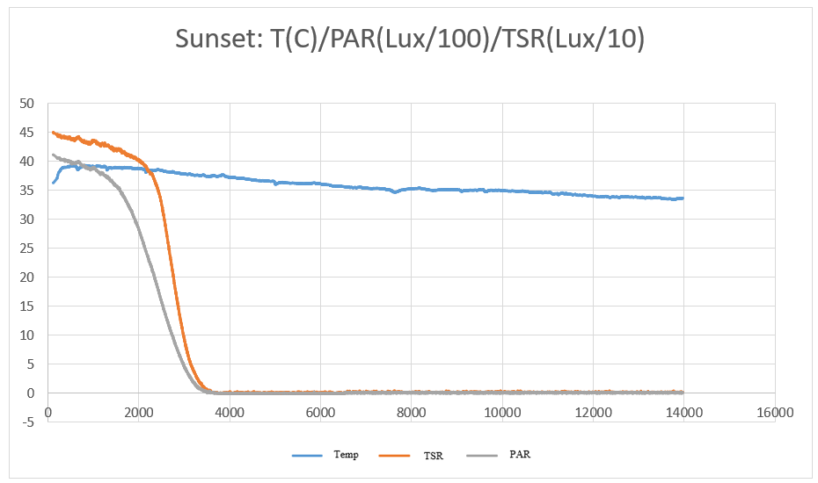
Sensing – Results

Slide 25
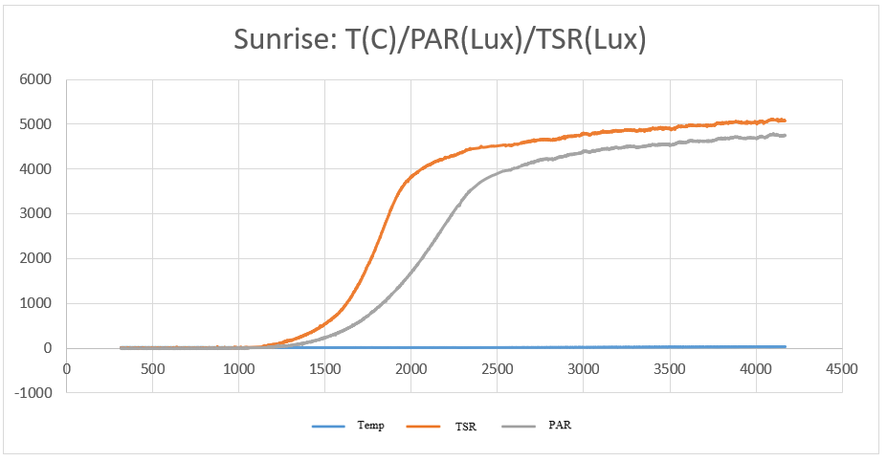
Sensing - Results

Slide 26
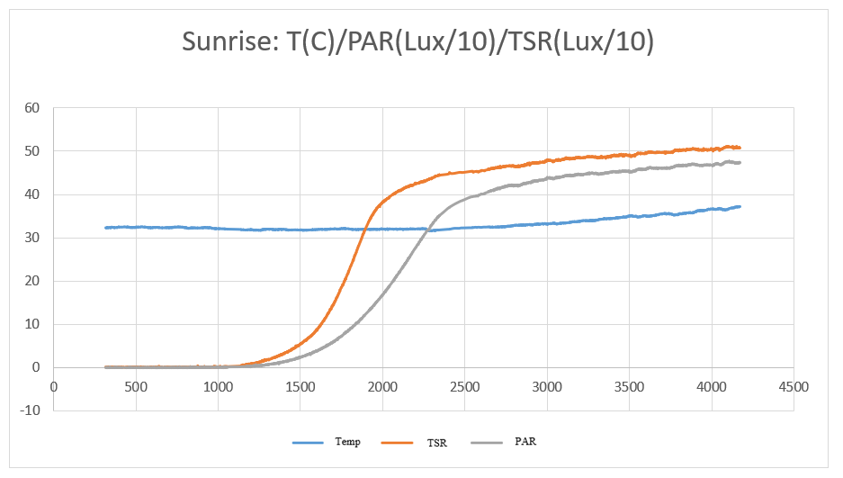
Sensing - Results

Slide 27
Findings
The ESP module worked with the input threshold levels and toggled the LEDs in as less than as 100-milliseconds testing environment. Wireless commands through the master control interface took less than a minute to communicate while Weather APIs generated local weather data instantly. All the 6 LEDs are connected on a single ESP which still have ample number of pins available for even more of the connections. Thus, costing around INR 500 only, this prototype is economical as well as reliable. The real-time location data is fed by Google Maps API that makes the changes in local geographical conditions to reflect immediately over the interface. As the light bulbs data is hosted on cloud, it is very easy to add new bulbs or edit their locations without changing the source code of the interface applications. The current issues with the LDR could be termed as Machine Errors and needs a human supervisor to guide learning the desired outcomes.

Slide 28
Conclusion
This project elaborates the design of server hardware circuit based on Wi-Fi based RISC processor and implementation of the LUA interface with mobile application that automatically controls the lighting system remotely. Hardware circuit works in a proper manner, with ESP8266 as the main processor component and LDR sensor to measure the intensity and hence the presence or absence of light. SMART STREET mobile android application works well as expected. Authorized users are able to control the lights easily and efficiently. The system has reduced the manual efforts and has automatized the control, thus saving energy. This automatic control system is useful in many applications for home, offices, institutions or large establishments.

Slide 29
Future Work
The above project could be developed using solar street light panels along with the automatic street light controller. The system could then supply itself power by harvesting the solar energy through a solar cell during day time through battery and provides a productive way for the operation of hardware circuit and controlling the light system. Automatic lighting system can be used for emergency, fault detections and for security purposes at home, offices or institutions as per requirement. This system can be used to automatically control home appliances, security burglar alarms, etc. It can be used to measure traffic density and can control traffic of the road. The Phase III of the project deals with Data-Mining and Machine Learning techniques implemented over the data collected by the sensors. This would make the local data available for even smallest of the streets and could make the whole of the area autonomous just attaching the module to the existing infrastructure.

Slide 30
Thank You!

